Slide 1
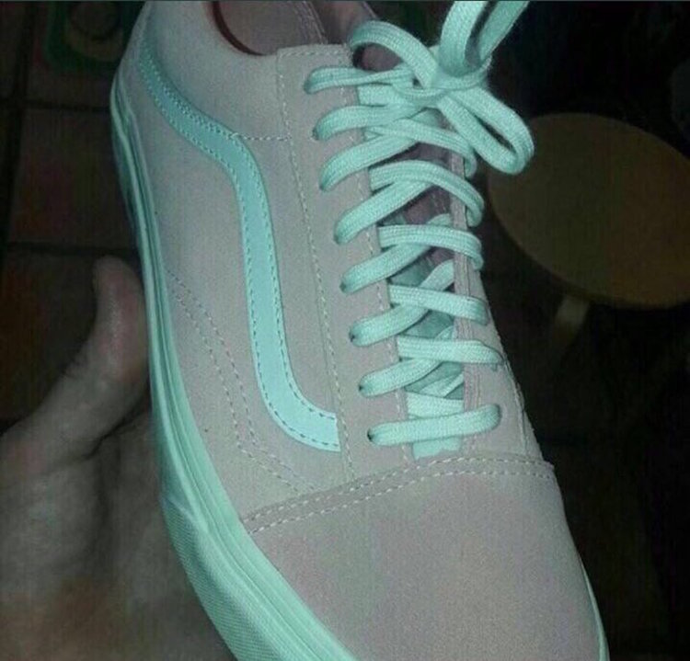
What Color am I?
Notes:
3 min
Before we begin
What color are these sneakers?
Are the folks who see them as blue wrong? What about the ones who see it as pink? Are you wrong?
Now that you know it *might* be the other color, can you start to see it?
Real-time Retro about what this might mean?
This simple activity teaches the participants that how you see something completely changes as your perspective does.
And our perspective is our reality.
So we’re asking you to consider how your perspective might be coloring your world and open your mind to the possibility that this might limit your ability to see things in a different way.

Slide 2
It’s not what you look at that matters
It’s what you SEE
- Henry David Thoreau
Photo by: Angelo Storari of Ancona, Italy
Notes:
1 min
If you Google the word agile, you’ll be able to look at a ton of information, 181 million results the last time I searched
But what we look at isn’t as important as HOW WE SEE IT
With agile, we’re still looking at the same thing – delivering the things our clients and customers need that will keep us in business
But HOW we see this makes all the difference
We’re going to go back to the heart of this thing we call agile. And then I’m going to ask you to engage yours.

Slide 3
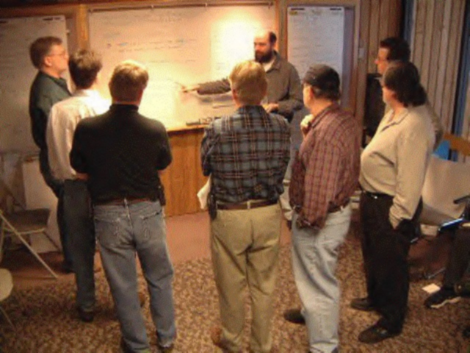
To understand today, study History
The Agile Manifesto
Notes:
4 minutes
You might have heard about the Agile Manifesto. So why would I mention it?
When we study history it helps us to realize we’re not so different from our ancestors
Gives us perspective
Get us comfortable that something we thought was a fact could be completely wrong
Then we can Admit when we’re wrong
Respect others might be right
Play the video
Thanks to VersionOne who have the best short video about the Manifesto History I could find.
It took them 2 days – about 5 hours a day – to write the Manifesto.
These folks didn’t agree on everything, and some still don’t (come talk to me later if you want to know more about that), but they agreed on these values.

Slide 4
Agile Manifesto Values
We are uncovering better ways of developing software by doing it and helping others do it. Through this work we have come to value:
Individuals and Interactions
Working Software
Customer Collaboration
Responding to Change
Processes and tools
Comprehensive documentation
Contract negotiation
Following a plan
OVER
Notes:
1 min
Were you paying attention? If not, here are the value statements again.
Why is it important to see this on one page?
Because we forget things we don’t see at least 3 different times, in 3 different ways, or have one REALLY memorable experience
*This is the second time*

Slide 5
Our teams aren’t following our new process...
let’s blame agile
Notes:
3 min
The Manifesto was created in 2 days
The Principles behind them took another 2 months
So why did they take the time to create the principles – over email – after the weekend at Snowbird was over?
According to manifesto author Alistair Cockburn: “What we wanted was that EVERY methodology produced had these characteristics”
How could they ensure this? By showing those who came after which direction they needed to go. The principles define that direction, and establish the true north.
Whenever an agile adoption is failing, we tend to blame agile. However, almost without exception, one or more of the principles are being violated in that adoption. So is it agile that’s failing? Or that we’re focusing on a process instead of the principles and values behind it?

Slide 6
Our highest priority is to satisfy the customer through early and continuous delivery of valuable software.
Build projects around motivated individuals. Give them the environment and support they need, and trust them to get the job done.
Continuous attention to technical excellence and good design enhances agility.
Agile processes promote sustainable development. Sponsors, developers, and users should be able to maintain a constant pace indefinitely.
Welcome changing requirements, even late in development. Agile processes harness change for the customer's competitive advantage.
Working software is the primary measure of progress.
Simplicity--the art of maximizing the amount of work not done--is essential.
The most efficient and effective method of conveying information to and within a development team is face-to-face conversation.
@thecolleene
Deliver working software frequently, from a couple of weeks to a couple of months, with a preference to the shorter timescale.
At regular intervals, the team reflects on how to become more effective, then tunes and adjusts its behavior accordingly.
The best architectures, requirements, and designs emerge from self-organizing teams.
Business people and developers must work together daily throughout the project
Notes:
15 min
Hopefully you’re looking for that guidance today. Because I’m going to ask you to decide what values YOU feel align to these Principles behind the Agile Manifesto next.
Game: Uncovering Better Things
In a few minutes, I’m going to divide you into 4 teams
Each team will be assigned a different color group
Each team will be given a list of values
As a team, I want you to go to the easel that matches your color
Once there, work together to select the top 10 Values that you think align to your group of principles
In your teams, you’ll need someone who will volunteer to write
Once you’ve select the values, your volunteer will write them on the stickies, and before you’re done I’ll ask you to put them on the Easels
I’m going to give you 10 minutes to do that, including forming your teams, so get ready now
Any questions?
Okay, ready? Set the timer for 2 minutes
*animation*
Okay, everyone from (pick a spot) to the wall is in Team Purple
From here (center) to here Team Red
Here (center) to (pick a spot) is Team Blue
Here to the wall is in Team Yellow
5 minutes in – if enough groups have more than 5 or 6
Okay, put your stickies on your easel
7 minutes in – okay, I want you to start to place them in priority order
Everyone takes a turn moving one card up or down
Set a timer for 3 minutes
When it goes off, they’re done
Focusing on the principles increases your agile mindset. Once you have that mindset, which process you follow is less important. You’ll uncover better ways.

Slide 7
We are uncovering better ways of developing software by doing it and helping others do it. Through this work we have come to value:
Individuals and Interactions OVER Processes and Tools
Working Software OVER Comprehensive Documentation
Customer Collaboration OVER Contract Negotiation
Responding to Change OVER Following a Plan
@thecolleene
Notes:
7 min
Okay, so you worked as a team to decide what the top values were for each principle. No, not these values. The ones your team came up with.
But this is the 3rd time you’ve seen the manifesto today. Hopefully you’ll remember them tomorrow.
Now, you’re going to have a chance to look at how YOU currently exhibit those values. Or not. And which ones you don’t exhibit that you might need to master.
On your chairs is a chart that says Start, Stop, Continue
If you’re already exhibiting those values, you’ll place them in Continue
Start are the ones you need to start working on
And Stop? What values are you going to have to let go of so you’re not in opposition to the values your group identified?
I’ll give you 7 minutes
As we start to exhibit the values behind the agile manifesto, people around us see what we’re doing, and they might even want what we’ve got

Slide 8
To change someone’s perspective
Look inside
@thecolleene
Notes:
2 min
How did this change the perspectives for our new agile teams?
We did a similar exercise with them, and each one came up with something different. And we decided that was okay.
Because how do you change someone else’s perspective? You don’t.
*animation*
You have to change yours first. And then you can help them figure out what values THEY need to Start, Stop, and Continue to align with their own understanding.
And that’s what our teams have done.
They no longer follow the methods as a process change only.
They engage their mind, body and especially their heart as they move towards a more agile workplace.
They exhibit leadership when they challenge the way things work around here.
They share their knowledge, regardless of title or role.
They decided to start pair programming, because it gave them a better chance to produce a product that worked.
Others have decided to eliminate all defects before they moved to production.

Slide 9
@thecolleene
Notes:
5 min
What did you see happening during the exercise with your team?
What did you feel as you were introspecting?
What came to your mind that you didn’t really want to think?
So What does that say to you?
What if everyone at your company looked at agile as a perspective change instead of a process change?
Now What is it you need to do as a result of today’s session?
I’ll post the deck afterwards on my website, so feel free to share this with others!

